Slide 1
Data Mining
Reference Books:
1) Introduction to Data Mining
Author: P N Tan, M Steinbach and V Kumar
2) Data Mining: Concepts and Techniques
Author: J Han and M Kamber

Slide 2
Association Analysis
Association analysis
It is a methodology which is useful for discovering interesting relationships hidden in large data sets
The uncovered relationships can be represented in the form of association rules or sets of frequent items
E.g. The rule {Bread, Sweet} → {Milk} can be extracted from Table 1
Applications
Market basket analysis, Bioinformatics, Medical diagnosis, Web mining, and scientific data analysis.
Support count
The support count for an item set X is σ(X) which refers to the number of transactions that contain item set X. The support count for the item set
    {Bread, Sweet, Milk} is 2.
TID | Items
1 | {Bread, Milk}
2 | {Diapers, Rice, Milk, Beer}
3 | {Bread, Sweet, Milk, Beer}
4 | {Bread, Sweet, Milk, Beef}
N = 4
X ={Bread, Sweet}
Y = {Milk}
s(X → Y) = σ(X ∪ Y) / N
= σ({Bread,Sweet} ∪ {Milk})/N
= σ({Bread,Sweet,Milk})/N
= 2/4=0.5
Or 50%
s=0.5
c(X → Y) = σ(X ∪ Y) / σ(X) = 2/2=1, or 100%

Slide 3
Association Analysis
Association rule
It is an implication expression of the form X → Y where X and Y are disjoint item sets, X ∩ Y = ∅.
The strength of an association rule is measured using support and confidence
Support
It determines how often a rule is applicable to a given data set
Support, s(X → Y) = σ(X ∪ Y) / N where N is the total number of records
Confidence
It determines how frequently items in Y appear in transactions that contain X
Confidence c(X → Y) = σ(X ∪ Y) / σ(X)
Frequent Itemset
Definition:
A frequent itemset is a set of items that appears together in a transactional database with a frequency (support) greater than or equal to a minimum support threshold.
Example:
If in a supermarket dataset, the itemset {milk, bread} appears in 60% of transactions and the minimum support is 50%, then {milk, bread} is a frequent itemset.

Slide 4
Association Analysis
Candidate Itemset
A candidate itemset is a set of items that is generated and tested during the mining process to determine whether it is frequent or not.
In algorithms like Apriori:
Candidates are generated in each pass.
Then, their support is counted.
Those meeting the minimum support are promoted as frequent itemsets.
Association rule discovery
Given a set of transactions T, find all the rules having support ≥ minsup and confidence ≥ minconf, where minsup and minconf are the corresponding support and confidence thresholds.
Association rule mining algorithm
Decomposes the problem into two major subtasks:
  Frequent item set generation: Find all the item sets that satisfy the minsup threshold called frequent item sets
  Rule generation: Extract all the high confidence rules from the frequent item sets found in the previous step called strong rules

Slide 5
Association Analysis
A data set that contains k items can potentially generate up to 2^{k} -1 frequent item sets excluding the null set.
To find frequent item sets, determine the support count for every candidate item set.
Compare each candidate against every transaction, If the candidate is contained in a transaction, the support count will be incremented.
The Apriori Principe
If an item set is frequent, then all of its subsets must also be frequent.
Frequent Item set Generation using The Apriori algorithm
It uses support-based pruning to systematically control the exponential growth of candidate item sets
Initially, every item is considered as a candidate 1-item set. The items which have minimum support are discarded
In the next iteration, candidate-2 item sets are generated using only the frequent 1-item sets
Candidate 3-itemsets are formed in the similar way. This process is continued until the frequent item set is null.

Slide 6
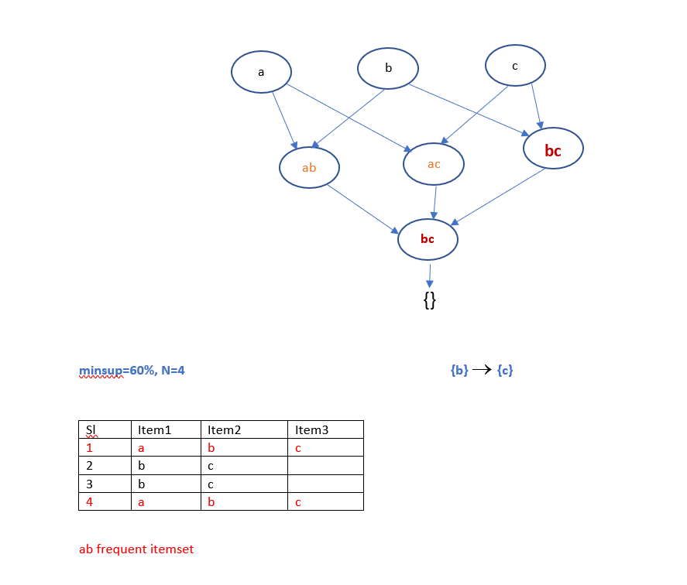

Slide 7
Association Analysis
Frequent Item set Generation using The Apriori algorithm
The following variables are used in the Apriori algorithm:
C_{k} → denotes the set of candidate k-item sets
F_{k} → denotes the set of frequent k-item sets
The algorithm initially makes a single pass over the data set to determine the support of each item. Upon completion of this step, the set of all frequent 1-itemsets, F₁ will be known (step 1 and 2)
The algorithm will iteratively generate new candidate k-itemsets using the frequent (k-1)-itemsets found in the previous iteration (step 5).
Candidate generation is implemented using a function called apriori-gen()
See Algorithm 6.1 Frequent itemset generation of the Apriori algorithm
To count the support of the candidates, the algorithm needs to make an additional pass over the data set (step 6-10). The subset function is used to determine all the candidate itemsets in C_{k} that are contained in each transaction t.
The algorithm eliminates all candidate itemsets whose support counts are less than minsup (step 12).
The algorithm terminates when there are no new frequent itemsets generated,
F_{k} = ∅ (step 13)
Total number of iterations = k_{max} +1 where k_{max} is the maximum size of the frequent itemsets.

Slide 8
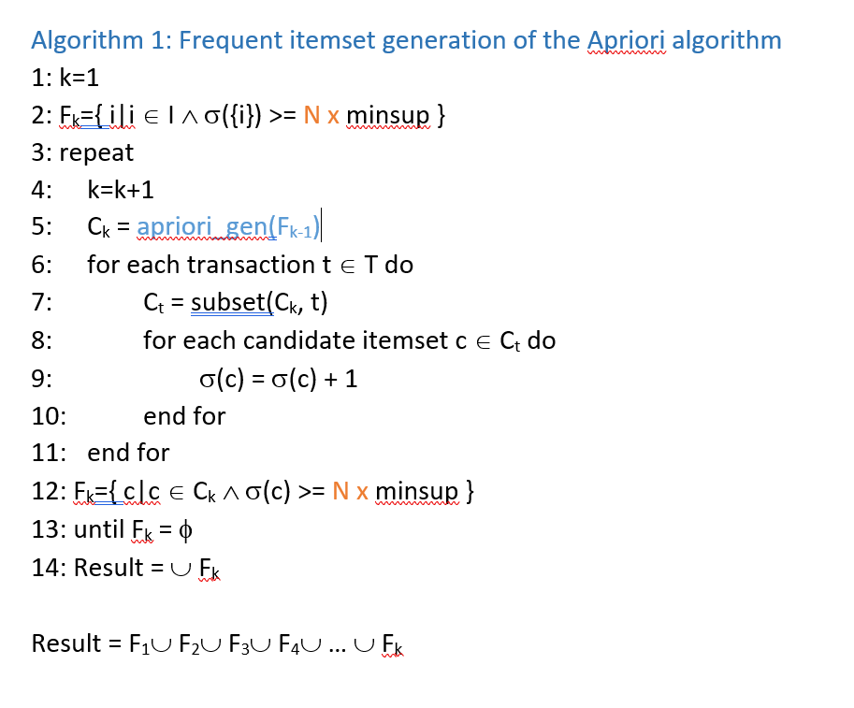

Slide 9
Association Analysis
Candidate Generation and Pruning
The apriori-gen() function generates candidate itemsets by performing the following two functions:
  Candidate generation: it generates new candidate k-itemsets based upon the frequent (k-1) itemsets found in the previous iteration
  Candidate pruning: This operation eliminates some of the candidate k-itemsets using the support-based pruning strategy. The infrequent item is immediately prunned.
Rule Generation
The ap-genrules() function generates the rules which are strong
See Algorithm 6.2 Rule generation of the Apriori algorithm
See Algorithm 6.3 Procedure ap-genrules()

Slide 10
It describes how to extract association rules efficiently from a given frequent itemsets
Y is a frequent k-itemset
If we make X and Y-X two partitions of Y, then X → Y-X is a rule

Slide 11
Algorithm 6.2: Rule generation of the Apriori algorithm
1: for each frequent k-itemset f_{k}, k≥2 do
2: H₁= {i|i∈f_{k}}
3: call ap-genrules(f_{k},H₁)
4: end for
Rule: {bc} → {ad}

Slide 12
Algorithm 6.3 Procedure ap-genrules(f_{k}, H_{m})
1: k=|f_{k}|
2: m=|H_{m}|
3: if k>m+1 then
4: …….
5: for each h_{m+1} ∈ H_{m+1}
6: …….
7: if conf>= minconf then
8: output the rule (f_{k} - h_{m+1}) → h_{m+1}
9: else
10: delete h_{m+1} from H_{m+1}
11: endif
12: …….
{abcde}. h_{m}=cd; Rule: {abe} → {cd}

